Slide 1
Algebraic Structures

Slide 2
What is an "Algebraic Structure"?
A collection of objects, and one or more operations that can be performed on those objects.
The objects can be numbers, but do not have to be.
We categorize algebraic structures based on the properties of the operations.

Slide 3
Why Do We Care?
Draw generalizations among number systems.
Discover new systems with similar properties.
Prove theorems about all systems with the same basic properties.

Slide 4
Applications of Group Theory
1. In Physics
- Indispensable role in determining selection rules for spectroscopic transitions (Atomic and Molecular Spectroscopy).
2. In Chemistry
- Analyzes symmetries and crystal structures of molecules.
- Studies molecular properties via molecular orbital theory.
3. In Robotics & Computer Science
- Used in robotics, computer vision, graphics, and medical image analysis (symmetry applications).
4. In Mathematics
- Classifies symmetric objects (e.g., circles under rotation).
- Applies to functions and operations.
5. In Cryptography
- Groups, subgroups, and cosets enable secure data transmission (e.g., Public Key algorithms).

Slide 5
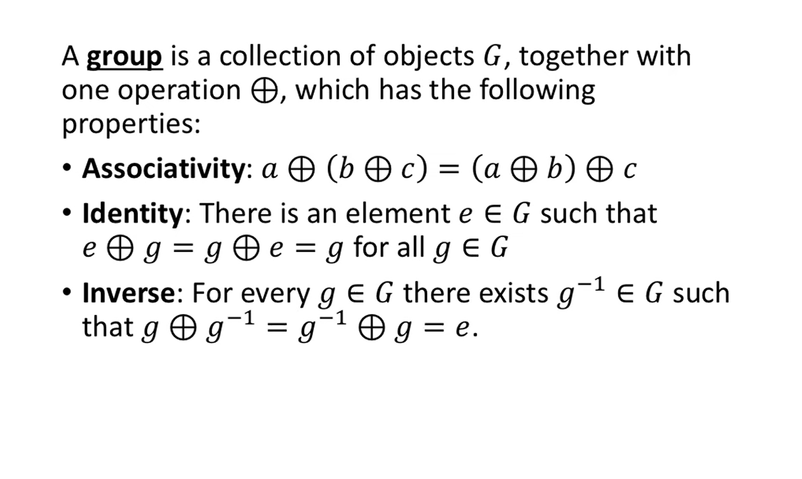
Groups

Slide 6
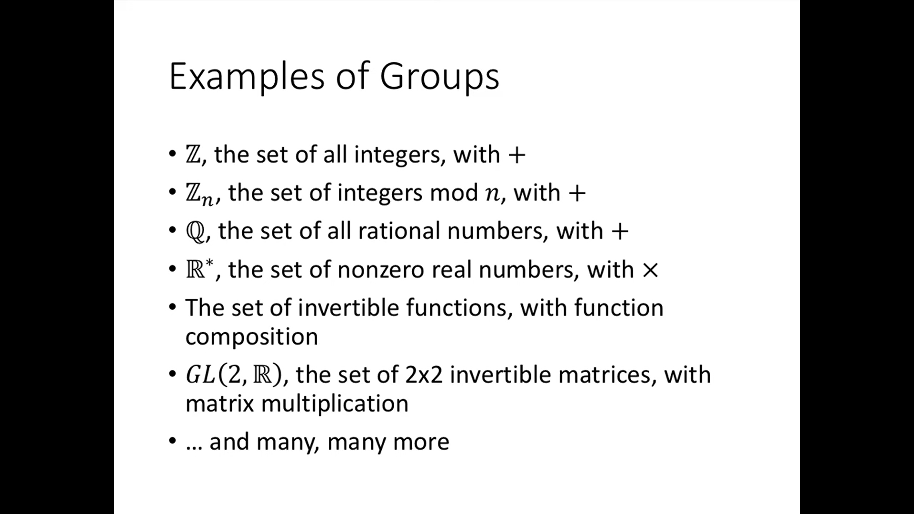
Examples of Groups

Slide 7
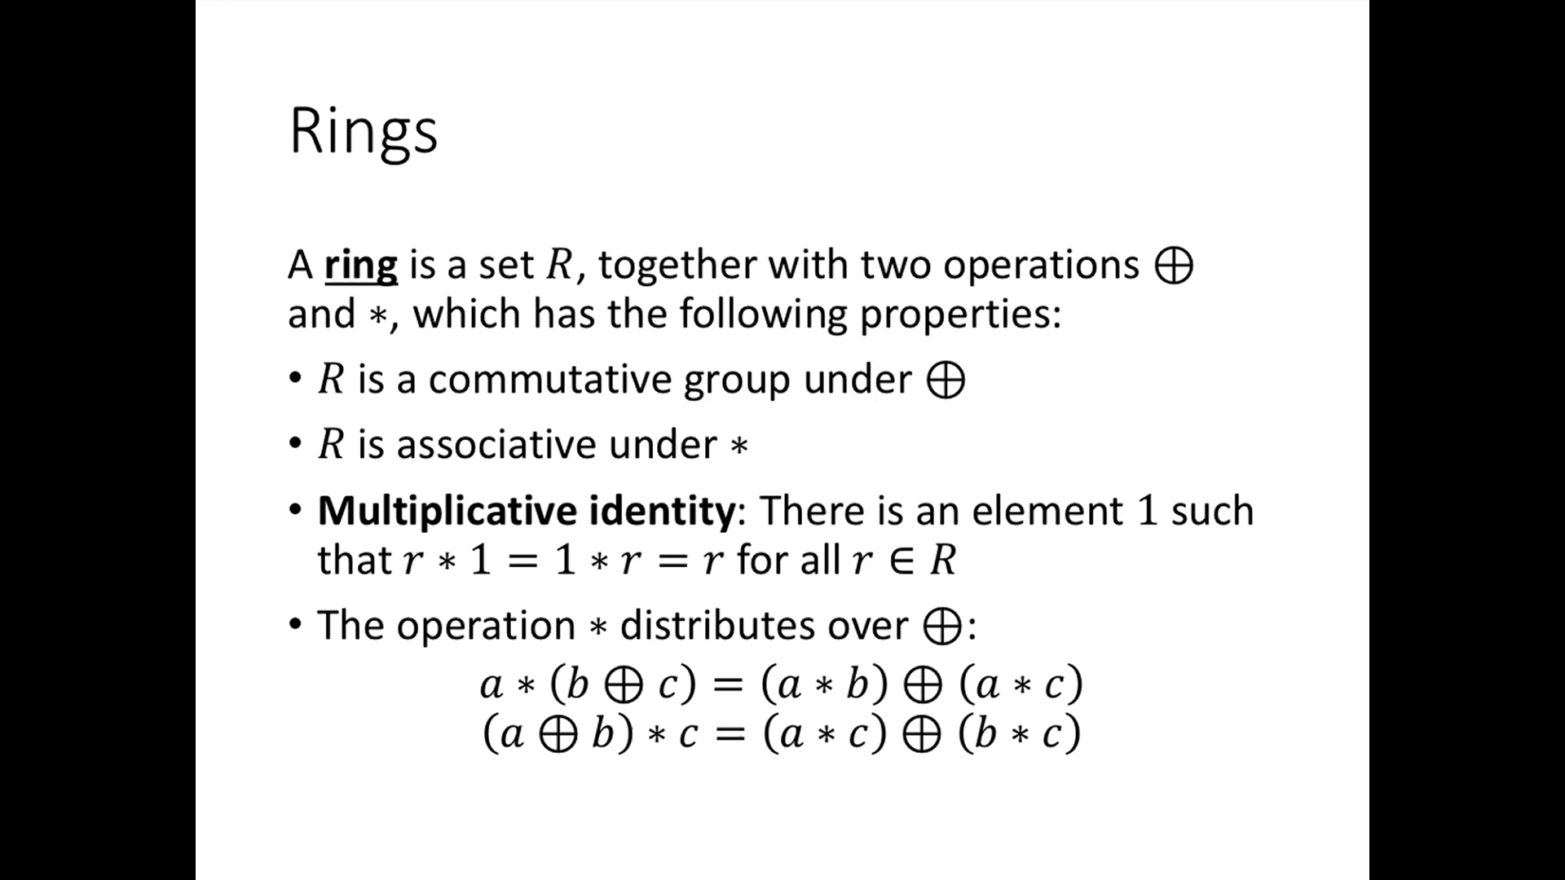
Rings

Slide 8
Monoid
A monoid is a set M with a binary operation (*) that satisfies:
Closure: If you take any two elements from the set and combine them using the operation, the result must still be in the set.
Associativity:The way you group the operations doesn’t matter. (a * b) * c = a * (b * c).
Identity Element: There exists e in M such that a * e = e * a = a.
Example: (N, +) where N is the set of natural numbers and 0 is the identity.

Slide 9
Monoid
Think of adding numbers:
Set: Whole numbers (0, 1, 2, 3,...)
Operation: Addition (+)
Why it works:
Any two numbers add to another whole number
(2+3)+4 = 2+(3+4) = 9
Adding zero changes nothing: 5+0 = 5

Slide 10
Abelian Group
An Abelian group is a group where the operation is commutative:
a * b = b * a for all a, b in G.
Example: (Z, +) is Abelian because addition is commutative.
Non-example: Matrix multiplication is generally not commutative.

Slide 11
Subgroups
A smaller group living inside a bigger group that follows all group rules.
A subgroup H of a group G is a subset that is itself a group.
Conditions:
Closure
Contains identity
Contains inverses
Notation: H ≤ G

Slide 12
Subgroups
Even numbers within integers:
Big group: All integers with addition
Subgroup: Even numbers with addition
Even + even = even (closure)
0 is identity
Inverse of 4 is -4 (both even)

Slide 13
Cyclic Group
A group generated by repeating a single element.
Rotating a pizza:
Set: {0°, 90°, 180°, 270°}
Operation: Adding rotations
Generator: 90° rotation
90°+90°=180°
90°+90°+90°=270°
90°×4=0° (full rotation)

Slide 14
Permutation Groups
A permutation group is a collection of all possible permutations of a set, combined with an operation (usually composition, meaning applying one permutation after another).
Shuffling 3 cards (ABC):
Possible orders: ABC, ACB, BAC, BCA, CAB, CBA
Combining swaps: Swap 1st/2nd then 2nd/3rd gives different result than doing it in reverse order

Slide 15
Key Takeaways
Monoid: Like a group but missing inverses (e.g., counting numbers with addition).
Group: A set where you can combine elements, undo operations, and has an identity.
Abelian Group: A group where swapping elements doesn’t change the result.
Permutation Group: All possible shuffles of objects.
Subgroup: A smaller group inside a bigger one.
Cyclic Group: A group generated by repeating a single element.

Slide 16
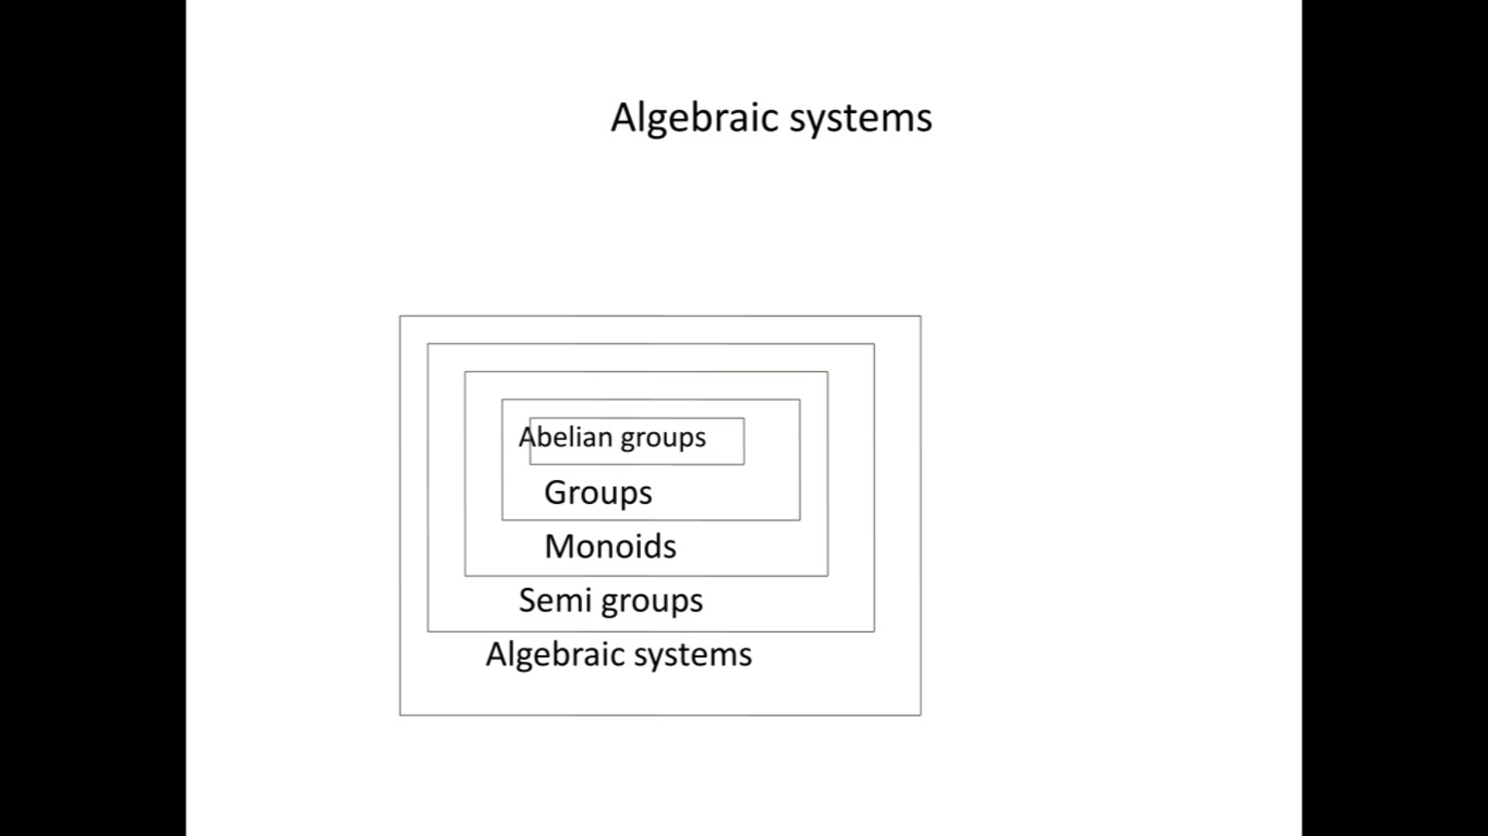
Algebraic Structures

